Slide 1

SQL 2024 Olympics analysis

Slide 2
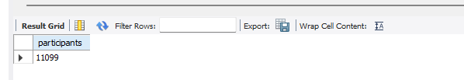
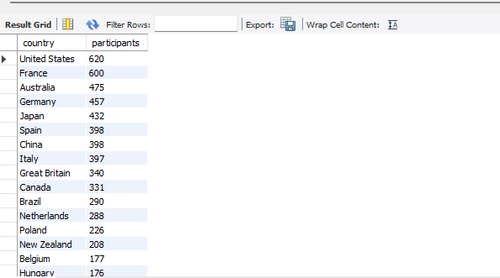
SQL Queries
List all Olympic data SELECT * FROM Olympic. 'athletes new`;
Total number of participants SELECT count(code) as participants FROM Olympic. 'athletes new`;
Total Number of participants per country
SELECT country, count(code) AS participants FROM Olympic. 'athletes new 'Group by country Order by participants desc;

Slide 3

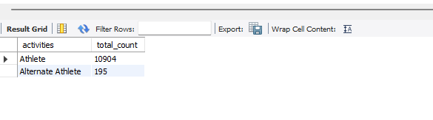

SQL Queries
Total number of Female and Male
SELECT SUM(CASE WHEN gender= 'Male' THEN 1 ELSE 0 END ) as Male, SUM(CASE WHEN gender= 'Female' THEN 1 ELSE 0 END) as Female FROM Olympic. 'athletes new`
Total number of function
Change the column name to activities as function is reserved keyword
ALTER TABLE Olympic. 'athletes new 'RENAME COLUMN `function` TO activities;
SELECT activities, COUNT(code) AS total count FROM Olympic. 'athletes new ‘ GROUP BY activities;
What is the average height and weight
SELECT avg(height) as Av height, avg(weight) as Av weight FROM Olympic. 'athletes new`

Slide 4
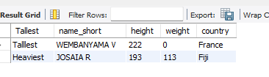

SQL Queries
Which participant is the tallest and which is the heaviest, and from which countries do they come? (SELECT 'Tallest' AS Tallest , name short, height, weight, country FROM Olympic. 'athletes new 'Order by height Desc Limit 1) Union All (SELECT 'Heaviest' AS Heaviest, name short , height, weight, country FROM Olympic. 'athletes new 'Order by weight Desc limit 1);
Which is the oldest and youngest participant and from which countries do they come?
(SELECT 'Oldest' As Oldest, name short, birthdate, TIMESTAMPDIFF(YEAR, birthdate, CURDATE()) AS age, country FROM Olympic. 'athletes new 'Order by birthdate as limit 1) union all (SELECT 'Youngest' AS younger, name short, birthdate, TIMESTAMPDIFF(YEAR, birthdate, CURDATE()) AS age, country FROM Olympic. 'athletes new 'Order by birthdate desc limit 1);

